Slide 1

Google Data Analytics-Case Study
Cyclistic Bike-Share : Data Analysis

Slide 2
Business Scenario.
You are a junior data analyst working in the marketing analyst team at Cyclistic, a bike-share company in Chicago. The director of marketing believes the company’s future success depends on maximizing the number of annual memberships. Therefore, your team wants to understand how casual riders and annual members use Cyclistic bikes differently. From these insights, your team will design a new marketing strategy to convert casual riders into annual members. But first, Cyclistic executives must approve your recommendations, so they must be backed up with compelling data insights and professional data visualizations.

Slide 3

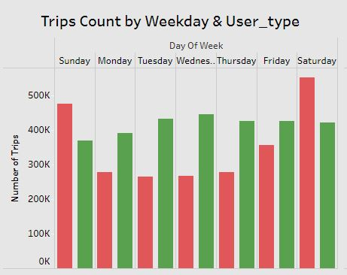
how does casual riders and annual members use bike differently?
The chart shows that Casual Riders mostly use the bike service during weekend , this implies they use it for relaxation.
The usage of bike service by member riders are high during weekdays, it means they mostly use it to commute to work.

Slide 4
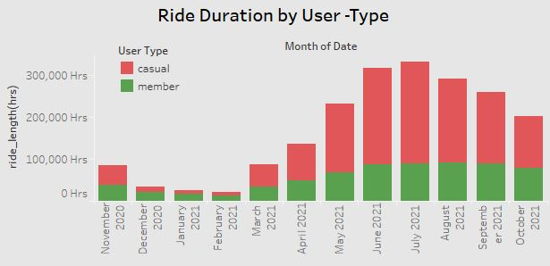
Key Findings
Over all the duration of ride length starts increasing during the spring season (from march to may).
During Summer season (from June to August) the duration of ride length are much higher as compared to spring season.
Ride length duration starts declining during Autumn season (from September to November)
The Least ride length are during Winter season (from December to February)
The ride duration for Casual riders are higher then Members.

Slide 5
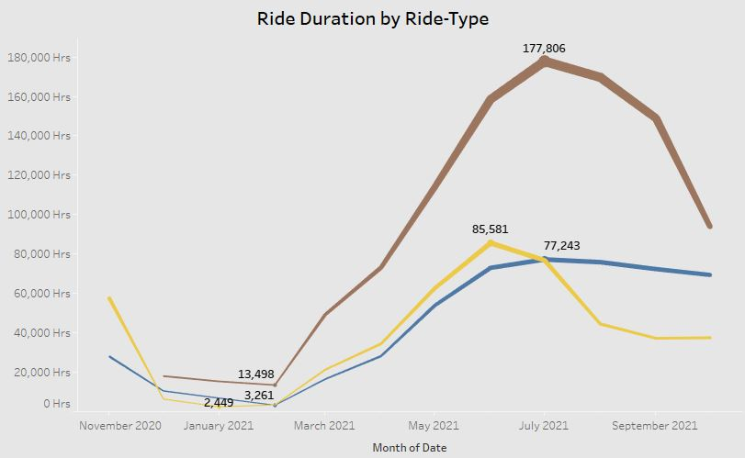
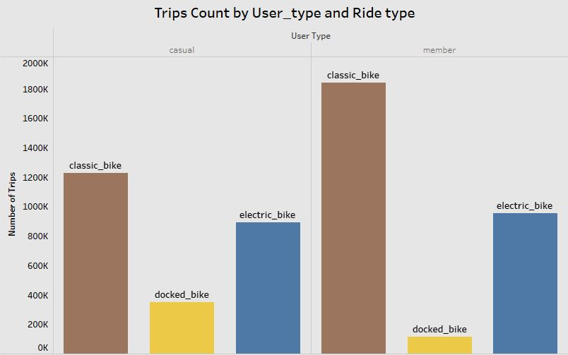

The ride duration and ride count for Classic Bikes are higher than other bikes.
Ride duration for Electric bike started increasing from Feb-2021, and was high on July-2021 after that it was consistent.
Docked bikes rides are very less than other bike types and the ride duration is declining from April-2021.

Slide 6
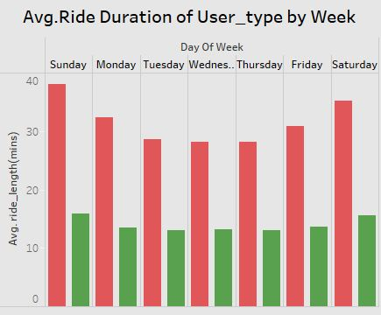
Average ride length for Casual riders are higher than member riders throughout the week.
Member riders have a consistent average ride length throughout the week.

Slide 7
Recommendations:
Providing free 7- days membership trails for Casual members, so they can get use the benefits and features of membership.
Creating awareness campaign about the various benefits of riding cycles in day to day like and also using as a transportation to commute to work.
Reaching out to the casual riders who ride more frequently and for longer durations , to explain how they can be benefited by taking membership.

